Slide 1

Financial Fraud Analyzer
Automating Document Review with NLP + Anomaly Detection
HG
by Hades Gaming

Slide 2





The Problem: Manual Fraud Detection
Manual Review
Analysts manually review thousands of financial documents.
Time Consuming
Over 70% of time is spent on data extraction and cross-checking.
High Error Risk
Human error leads to missed fraud or false positives.
Significant Losses
An estimated $42B is lost annually to financial fraud.

Slide 3





Our Solution: AI-Powered Analyzer
NLP Models
Anomaly Detection
Explainable AI
Uses pre-trained NLP models to understand documents.
Built-in XAI justifies each flagged item.
Applies Isolation Forest to detect abnormal amounts.
Easy Integration
Streamlit app or Slack bot for instant insights.

Slide 4





Architecture Overview
Input
PDF invoice or loan application.
NLP Extraction
LayoutLM/Donut extracts key fields.
Fraud Detection
Isolation Forest flags anomalies.
Explainability
SHAP/LIME highlights reasons for flags.
UI
Results shown via dashboard or Slack alerts.

Slide 5

How It Works: End-to-End Demo
User Story
Flagged Entries
Bank employee uploads 100 loan applications. AI flags 5 high-risk cases.
AI flags income mismatches or fake documents.
Demo Capabilities
Upload PDF batches, view parsed results, see fraud probability, export reports.

Slide 6
Build Breakdown: <20 Hours to MVP
Data Input
1
2 hrs: Use Kaggle/mock invoices/loan docs.
2
NLP Extraction
5 hrs: Fine-tune LayoutLM to extract fields.
Anomaly Detection
3
5 hrs: Train Isolation Forest on features.
4
Explainable AI
3 hrs: Use SHAP to explain predictions.
UI/Integration
5
5 hrs: Build Streamlit app or Slack notifier.

Slide 7
Why This Wins: Value Proposition
Fast Impact
Clear ROI
Built in <20 hours, deploys with PDFs/emails.
70% reduction in manual time.
No Infra Needed
40–60% increase in fraud detection.
Works without IoT/sensors.
Scalable
Expand to contracts, insurance claims, more.

Slide 8

Business Use Cases
Use Case
Impact
Loan Application Review
Auto-flag mismatched income, fake docs.
Invoice Verification
Detect vendor overcharging, date fraud.
Claims Processing
Spot fake or altered insurance claims.
Internal Audits
Identify suspicious patterns in expense reports.

Slide 9






Bonus: Gen AI Layer (Optional Extension)
Summarize Anomalies
Summarize flagged anomalies in plain English.
Translate Explanations
Auto-Emails
Translate explanations for multilingual clients.
Generate rejection/approval emails.

Slide 10
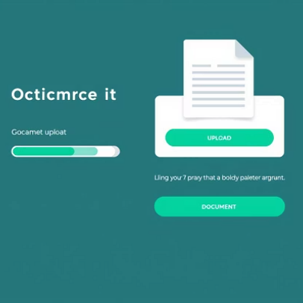
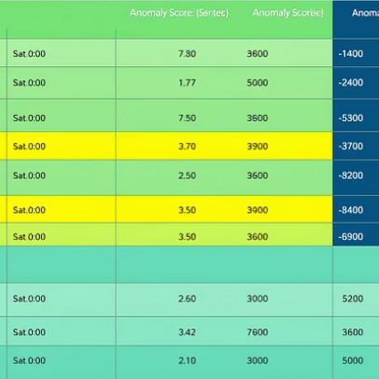
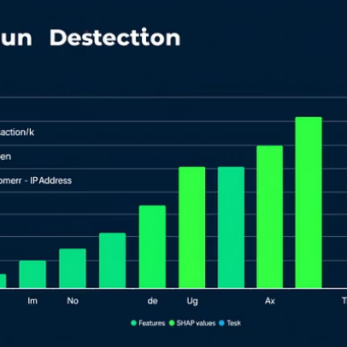
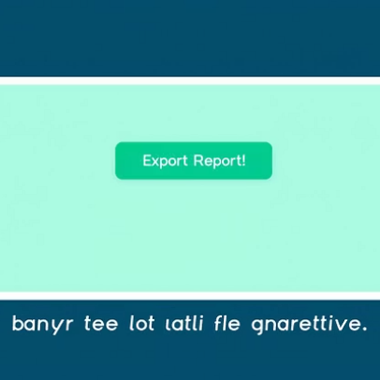
Live Results (Optional Demo Screenshot)
This gallery showcases the key features of our AI-Powered Financial Fraud Analyzer in action, from document upload to detailed anomaly explanations and report generation.

